Slide 1
Cooperating with exchanges in China & next generation services to support Chinese players
May 2012 – CIIS International Vendor Conference
Jutta Werner

Slide 2
Agenda
Cooperating with Chinese exchanges
Next generation services & solutions to support Chinese players
  Eikon and Chinese localised desktop
  Trading China Community
  Enterprise Platform for exchanges
  Corporate Services
Questions & Answers

Slide 3
Cooperating with Chinese exchanges
Leveraging our global data distribution network
  Bring China data to every corner of the world
  Raise interest & attract new investors
Sharing of best and global practises in Market Data
  Share practises and policies of other exchanges
  Help exchanges to achieve their objectives
  Introduce new areas of possible cooperation
Introduction to industry bodies such as FISD
  Foster cooperation across borders
  For the voice of the Chinese exchanges to be heard globally
  BIPPS and other working groups output

Slide 4
Eikon and Chinese localised Desktop
Eikon launched in 2010
Chinese version already live
Supports cross markets – Equity, C&E , FX&MM
Trading China community
  Here comes a little glance….

Slide 5
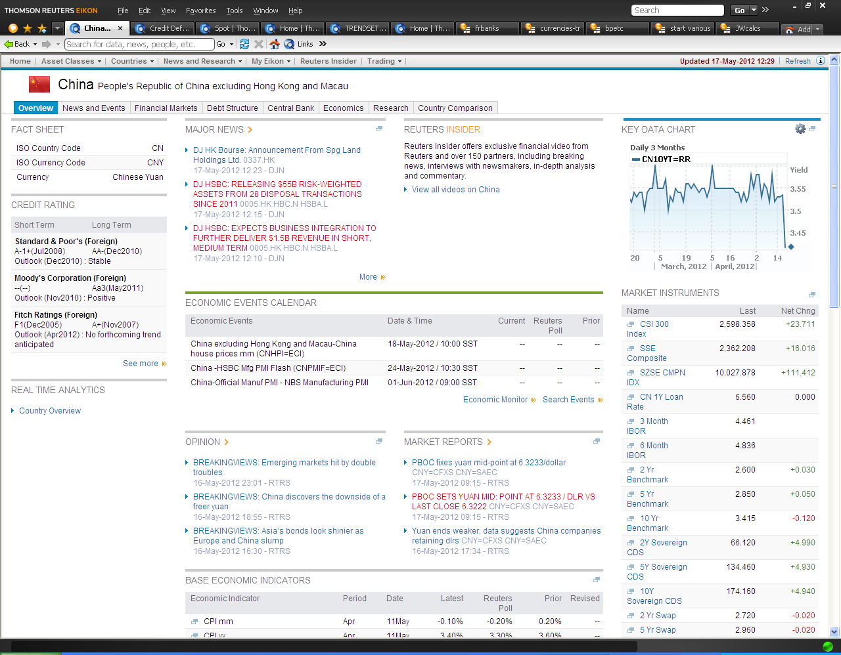

Slide 6
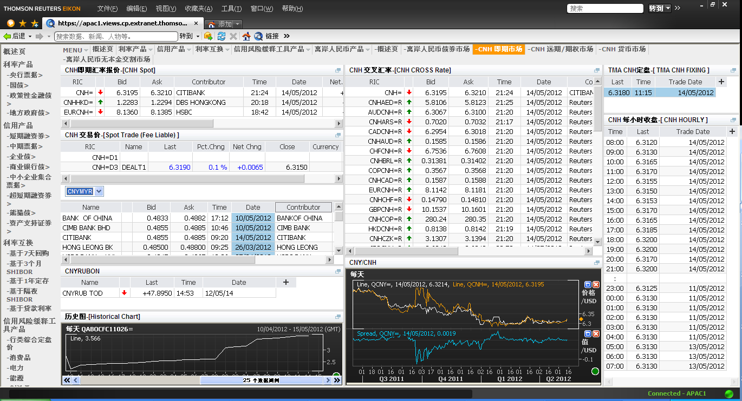
CHINA PRICE DISCOVERY

Slide 7
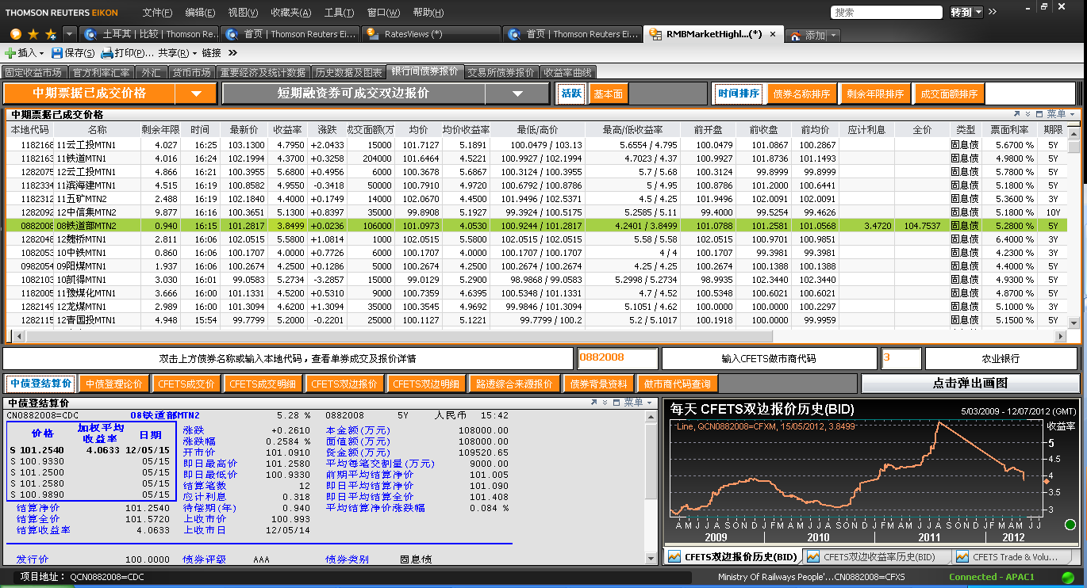
RMB MARKET HIGHLIGHTS

Slide 8
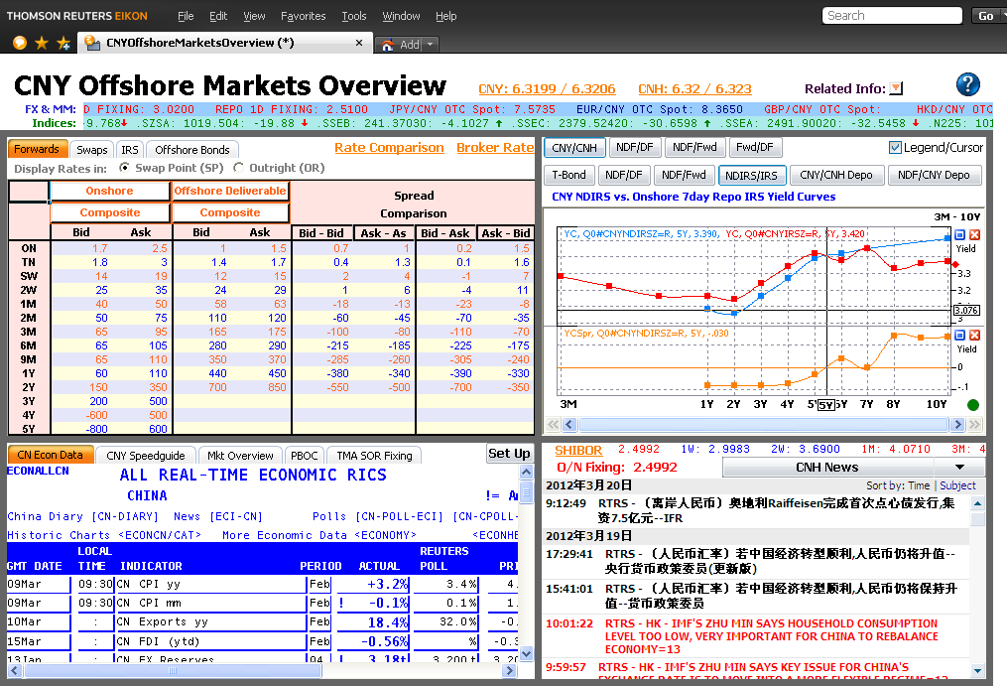
CNY OFFSHORE CONTENT AND ANALYTICS

Slide 9
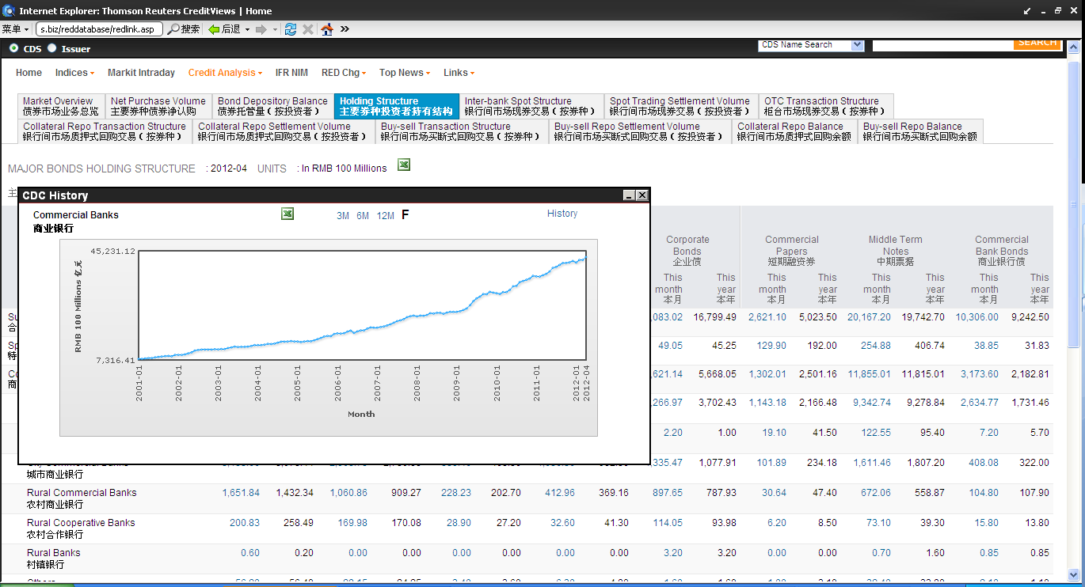
CREDITVIEWS – CHINA BOND MARKET STATISTICS – Credit Research from brokers etc.

Slide 10
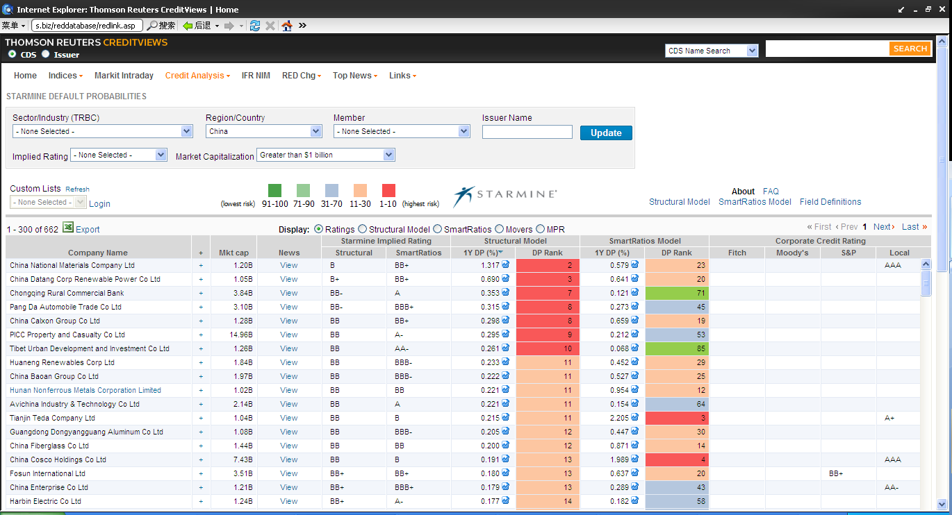
CREDITVIEWS – CHINA CREDIT RISK

Slide 11
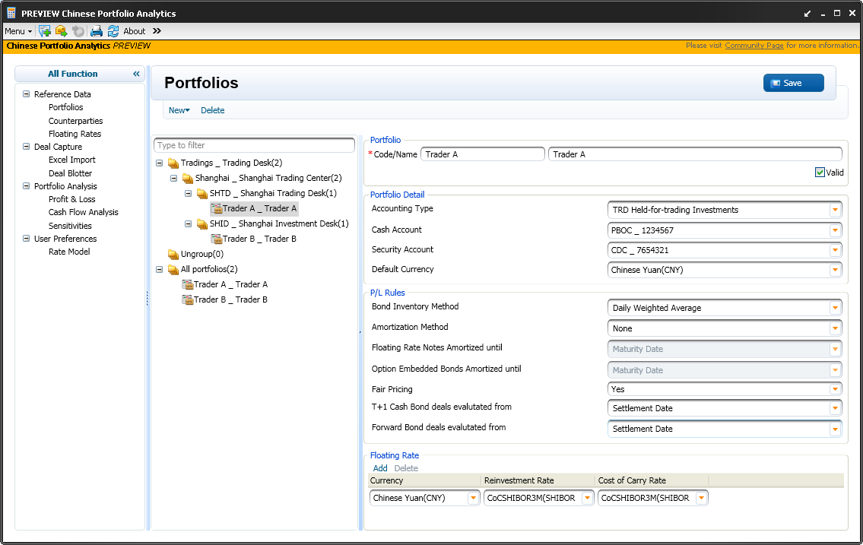
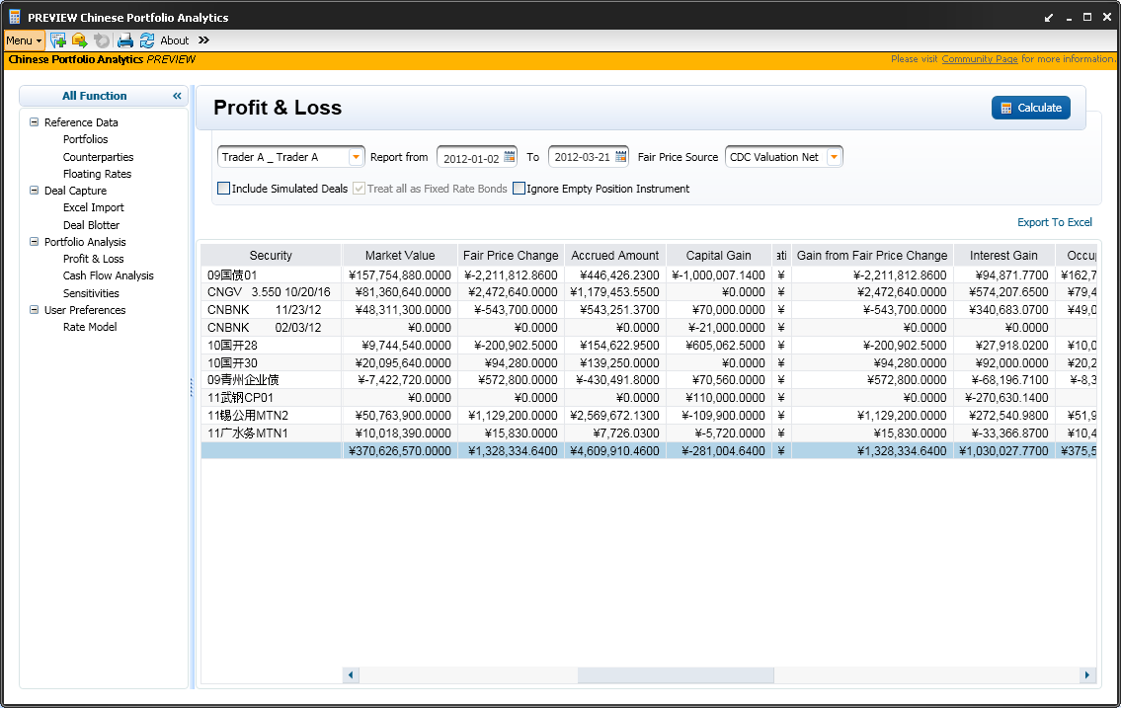
CHINA FIXED INCOME PORTFOLIO ANALYTICS

Slide 12
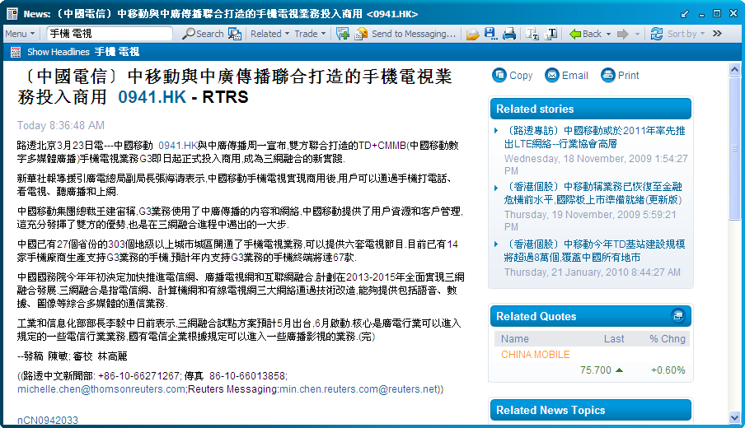
SALES ENQUIRY
Pinpoint the precise story using local language keywords
Correlate price movements on related stocks & related stories in the same context
Easy access to actionable, insightful news that empowers your trading decision

Slide 13
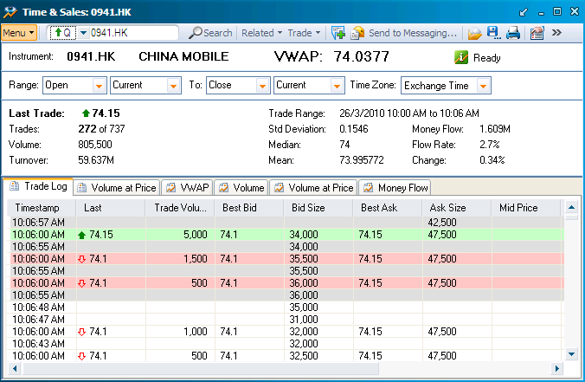
PRICE DISCOVERY
Access to 30 day of TAS on any instrument & track together with individual quotes right away
Gauge market sentiment on any stock anytime

Slide 14
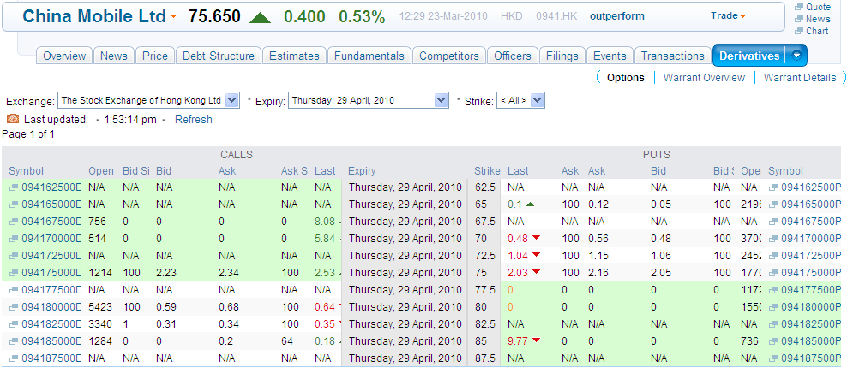
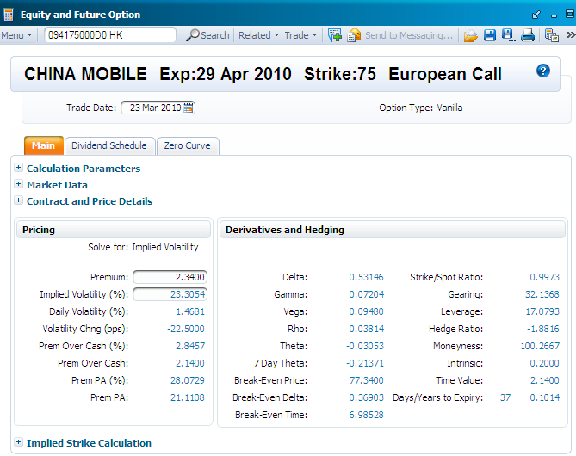
PRICE DISCOVERY
Efficiently view & compare pricing on options to spot opportunity
Evaluate current price and calculate theoretical using own assumptions

Slide 15
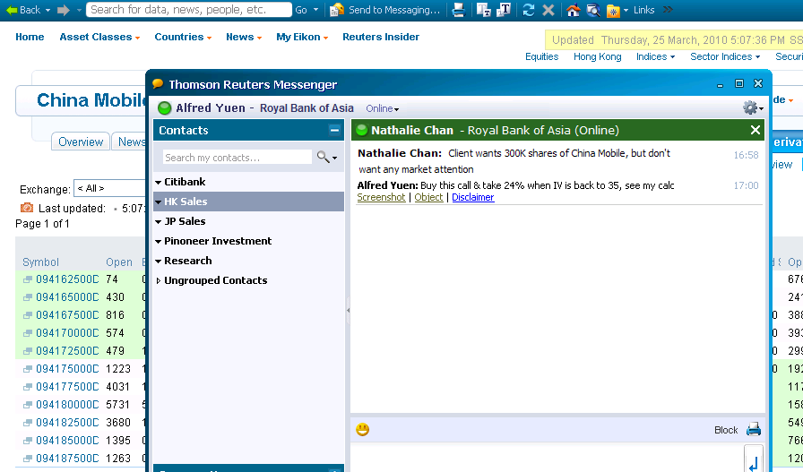
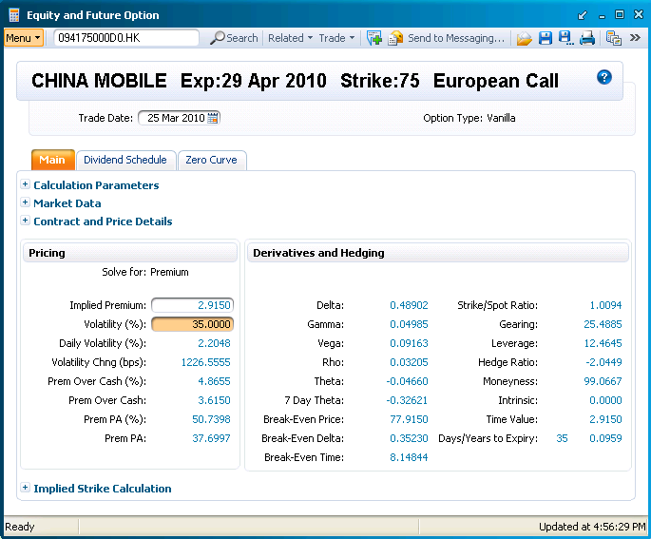
SUBSTANTIATE ARGUMENT
Send recommendation via IM and support argument with live content
Such that audience can see for themselves

Slide 16

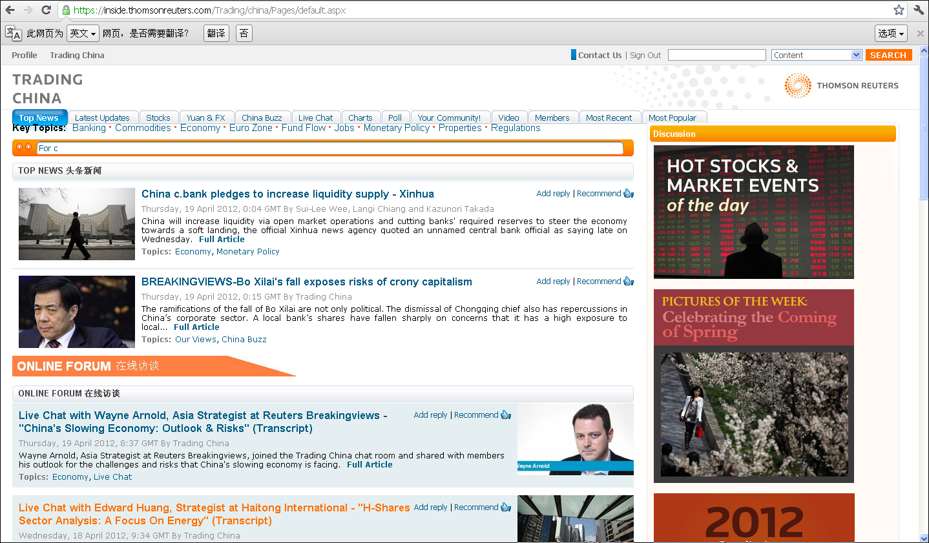
Trading China Portal
Notes:
16

Slide 17
Thomson Reuters Enterprise Platform
  Developed and enhanced over the course of 20 years
  Global Footprint of installations – Over 3000 sites
  Ultra low latency - 82 microseconds
  Ultra high throughput – 40+ Million ups
  Highly resilient and fault tolerant
  Highly extensible and Open middleware layer – 50,000 applications
  Off-the-shelf software ensures rapid TTM

Slide 18




THOMSON REUTERS ENTERPRISE PLATFORM
Real Time
Data
News
Internal
Sources
Brokers
Direct
Feeds
SOURCE
INTEGRATION
Data Calc
Access
Control
Conflation
Analytics
Data
Transform
ADDED
VALUE
CAPABILITIES
Users
Applications
Remote
Sites
Mobility
Internet
DISTRIBUTION

Slide 19
Exchange related Market Data Capabilities
Powered by TREP-RT
Thomson Reuters can provide services and capabilities in the following areas:
  Historical (Tick-by-Tick) management and distribution
  Index Calculations and Complex Event Processing/Analytics Support
  Enriched Statistical data (days High, Low, Total Volume etc)
  Configurable levels of Market depth for differentiated tiers/packaging of data.
  Message/Image recovery
  Managed Services, CoLo and Hosting
  Variety of downstream Delivery/Protocols options
  Snap/Delay/Conflated/Intervalised Delivery

Slide 20
Case studies - Business Drivers
Asian exchange- Delayed data feed
HKEX – co-location and managed services
NYSE – market maker terminals
DJIA – Support of Index Data Business

Slide 21
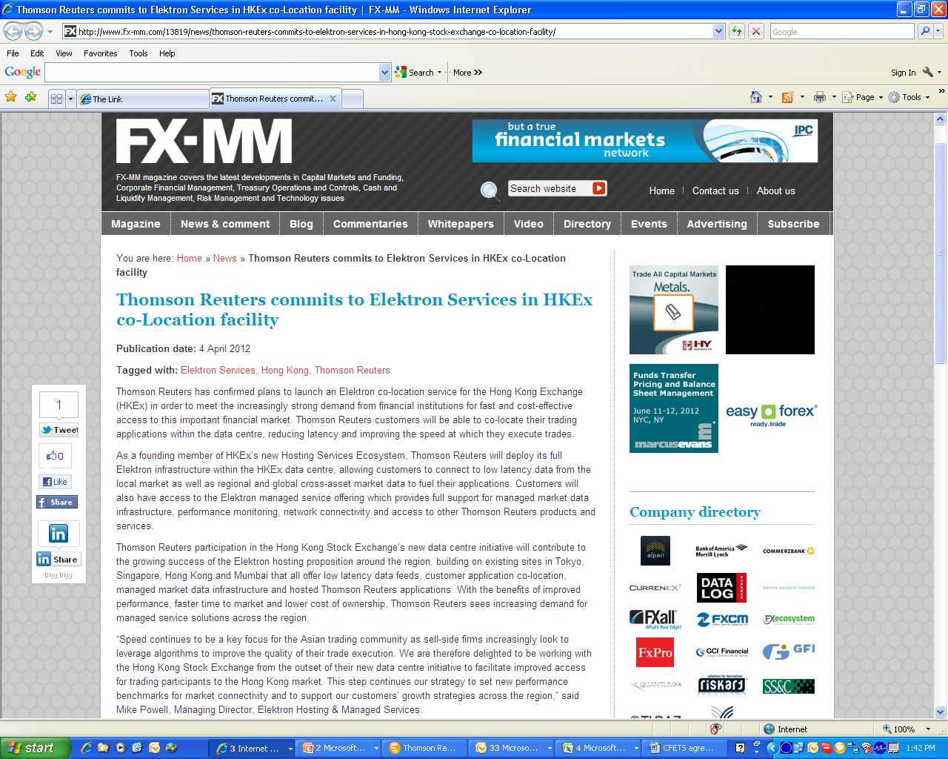

Slide 22


Slide 23
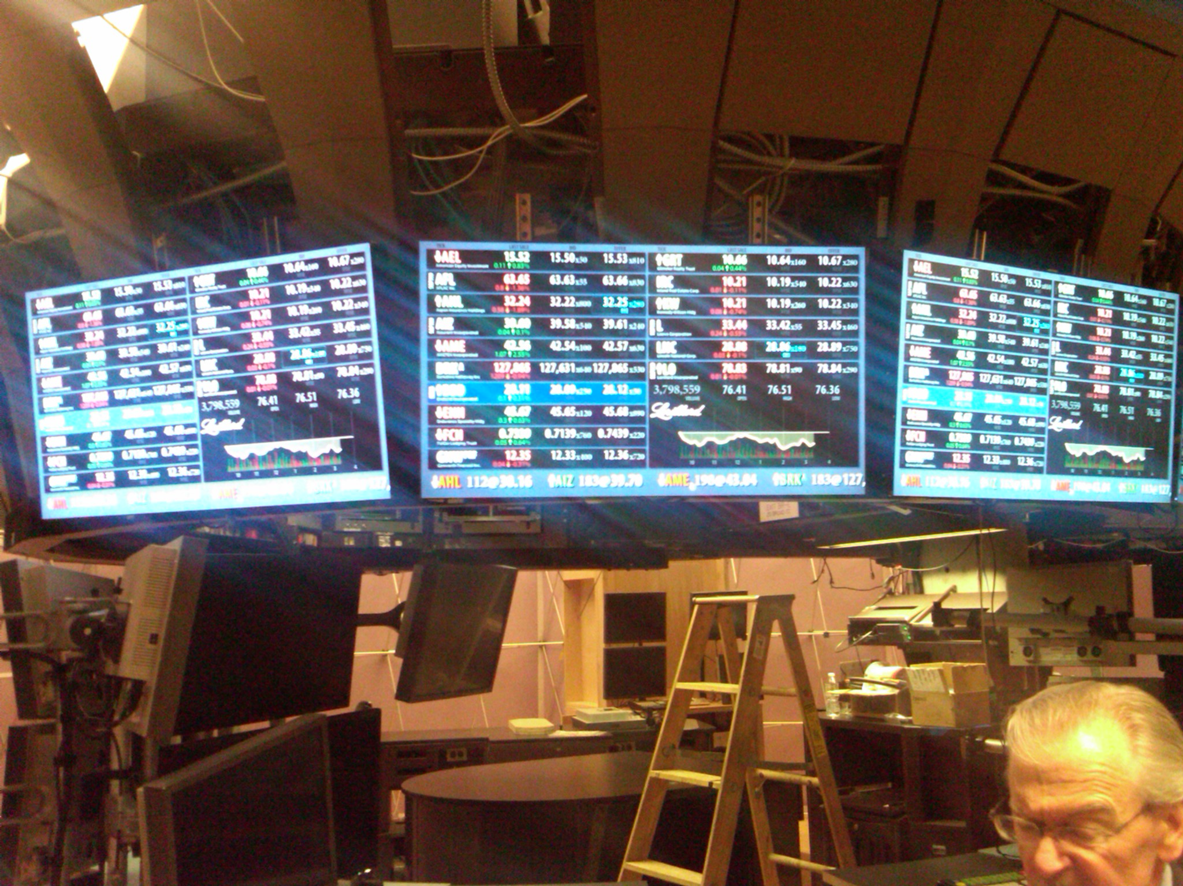

Slide 24
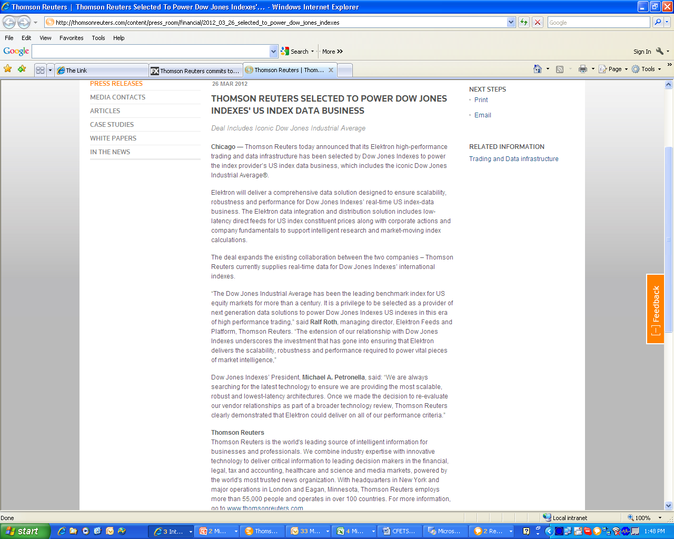

Slide 25
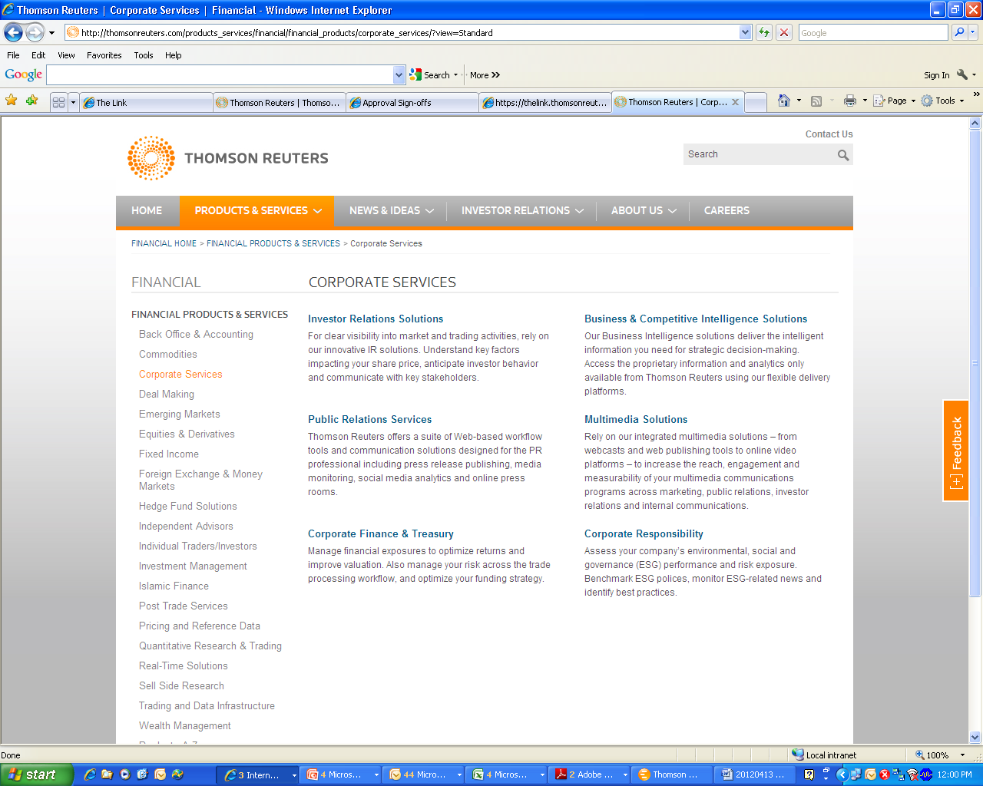
Corporate Services

Slide 26
Q&A
Thank You!
26
Notes:
26
26

